Slide 1
Predictive Maintenance of Water Pumps in Tanzania
Enhancing Service Delivery Through Data Science, by Leonard Koyio

Slide 2
1. Introduction
Overview: This project focuses on using data science to enhance the maintenance of water pumps in Tanzania.
Importance: Functional water pumps are crucial for reliable water supply, especially in rural areas.
Goal: Our aim is to predict the status of water pumps to ensure timely and efficient maintenance.

Slide 3
2. Business Understanding
Business Objective: Assist the Tanzanian government in optimizing water pump maintenance by predicting pump functionality, ensuring consistent access to clean water for communities.
Business Problem: Inefficient allocation of maintenance resources due to a lack of predictive insights, leading to over-servicing functional pumps and under-servicing those needing repairs, increasing costs and water supply disruptions.

Slide 4
2. Business Understanding
Business Benefits
Improved Resource Allocation: Prioritize critical units, optimize resource use, and enhance service delivery by focusing efforts on pumps needing immediate attention.
Cost Savings:Reduce repair costs and extend pump lifespan through preventative maintenance, leading to significant long-term savings.
Enhanced Water Access: Ensure better access to clean water, vital for public health, by reducing non-functional pumps and improving water service reliability.

Slide 5
2. Business Understanding
Data-Driven Decision Making: Foster a culture of data-driven strategies, improving efficiency in water pump maintenance and setting a precedent for other public services.
Improved Service Delivery: Targeted and efficient maintenance approach reduces downtime and ensures quicker repairs, enhancing public trust and satisfaction with government services.

Slide 6
3. Data Understanding
Dataset Description: The dataset includes information on various features influencing the status of water pumps.
Key Features:
GPS Height: Elevation of the pump location.
Age: Age of the water pump.
Population: Population served by the pump.
Extraction Type: Type of extraction method used.
Quantity Group: Water quantity availability (e.g., seasonal, insufficient, enough).

Slide 7
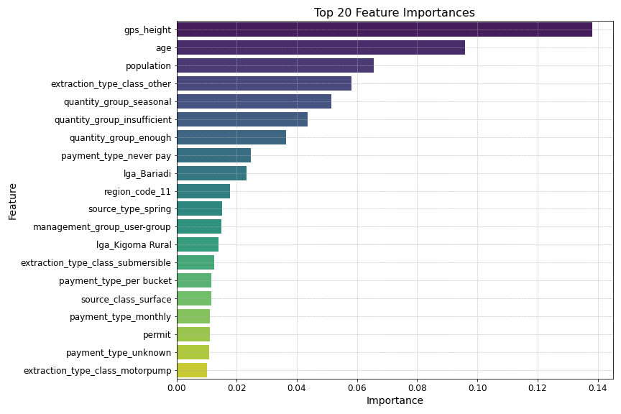
Visualization : top 20 model features

Slide 8
4. Exploratory Data Analysis (EDA)
Data Cleaning:
Remove Redundant Columns: Eliminated columns with no predictive value or columns with repeated data to streamline the dataset.
Handle Missing Values: Filled zeros and NaNs with suitable data, such as median or mean values, to maintain data integrity.
Data Transformation:
Min-Max Scaling: Applied Min-Max Scaling to normalize the range of independent variables, ensuring all features contribute equally to the model.
One-Hot Encoding: Converted categorical variables into binary vectors to allow the model to interpret them effectively.
Feature Engineering:
Age of the Pump: Calculated the age of each pump by subtracting the installation year from the current year, providing a crucial feature for predicting functionality.

Slide 9
5. Modeling
Baseline Models:
Developed initial models using Logistic Regression and Decision Trees with default hyperparameters to establish a performance benchmark.
Iteratively tuned models based on performance metrics.
Class Imbalance Handling:
Class Weights: Adjusted weights to handle class imbalance within the model.
SMOTE: Used Synthetic Minority Over-sampling Technique to balance class distribution by generating synthetic samples for the minority class.

Slide 10
5. Modeling
Model Regularization:
L1 Regularization: Promotes sparsity by driving some coefficients to zero, improving model interpretability.
L2 Regularization: Penalizes large coefficients to reduce overfitting, enhancing model generalizability.
Decision Tree Tuning:
Criteria: Compared Gini and Entropy criteria to determine the best split quality measure.
Max Depth Optimization: Tuned the maximum depth parameter to prevent overfitting and improve model performance.

Slide 11
6. Model Evaluation
Settled Model: Decision Tree trained on dataset without outliers.
Class Imbalance Handling: SMOTE to balance class distribution.
Criterion: Gini impurity criterion.
Max Depth: None specified.
Metrics:
Weighted Recall: 0.7128
Indicates that the model correctly identifies 71.28% of instances, considering class distribution, which is critical for ensuring non-functional and repair-needed pumps are detected.
Weighted Precision: 0.7443
Shows that 74.43% of the positive predictions are correct, reflecting high accuracy in identifying pumps needing attention.

Slide 12
6. Model Evaluation
Weighted F1 Score: 0.7253
Balances precision and recall, ensuring the model is effective in both identifying and accurately predicting pump statuses.
ROC AUC Score: 0.7626
Measures overall performance; a score of 0.7626 indicates a good balance between sensitivity and specificity, which is suitable for our objective of predictive maintenance.

Slide 13
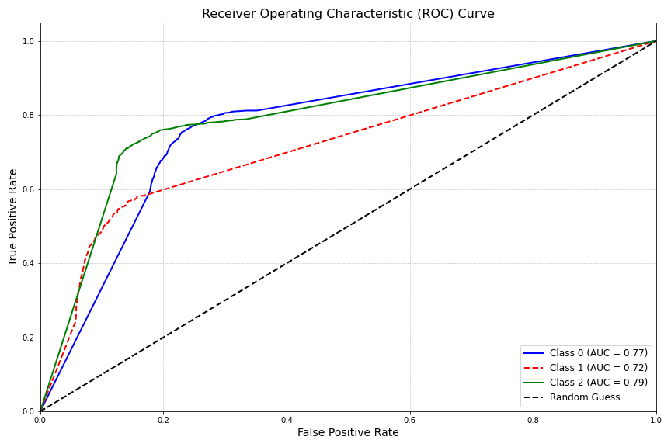
7. Model Visualizations : a. ROC Curve
Class 2 (Non-Functional): High AUC of 0.79 ensures accurate identification of out-of-service pumps, crucial for timely repairs.
Class 1 (Needs Repair): AUC of 0.72 indicates good detection of pumps needing maintenance, preventing further issues.
Class 0 (Functional): AUC of 0.77 helps confirm operational pumps, reducing unnecessary checks and optimizing resource use.

Slide 14
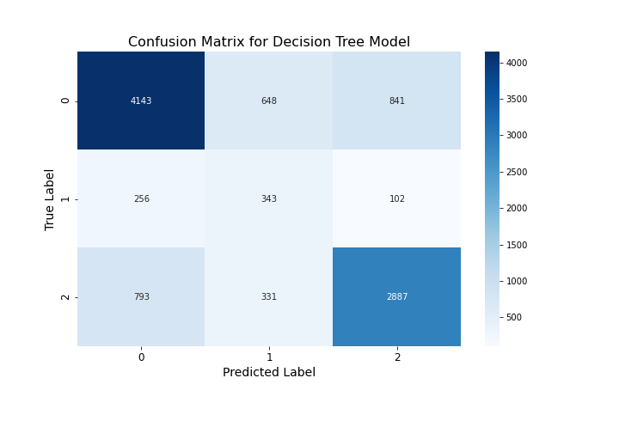
7. Model Visualizations : b. Confusion Matrix
Key
0 - Functional
1- Functional Needs Repair
2- Non- Functional
The model is well-balanced, with no strong bias towards any class, ensuring fair consideration of all pump statuses.

Slide 15
8.Predictive Recommendations
1. Investigate Zanzibar South (Region Code 11): Address regional-specific challenges affecting pump performance to enhance maintenance efforts.
2. Strengthen Bariadi's Local Government Authority: Support Bariadi’s LGA with training, resources, and funding to better manage and maintain pumps.
3. Tailor Maintenance by GPS Height: Customize maintenance schedules based on pump elevation to address altitude-related issues.
4. Focus on Older Pumps: Implement proactive maintenance strategies for older pumps to extend their lifespan and prevent failures.

Slide 16
8.Predictive Recommendations
5. Improve Seasonal and Insufficient Water Supply: Enhance maintenance practices for pumps with seasonal or insufficient water supply to ensure consistent water availability.
6. Train Communities for Handpump Maintenance: Provide training for communities to effectively maintain handpumps, reducing failure rates.
7. Promote Regular Payment for Water Services: Encourage consistent payment for water services to support sustainable maintenance funding.
8. Allocate Resources Based on Population: Prioritize maintenance resources for areas with higher populations to manage increased wear and tear.

Slide 17
8.Predictive Recommendations
Model Utility:
Most Useful: In rural or remote areas where quick maintenance decisions are crucial. Helps prioritize repairs and maintenance.
Less Effective: In rapidly changing conditions or where historical data is outdated.
Suggestions for Improvement:
Data Accuracy: Ensure accurate and up-to-date data on pump conditions and maintenance.
Feature Engineering: Add features related to usage patterns, maintenance history, and environmental conditions.

Slide 18
9. Project Impact
Improved Maintenance Efficiency: Enables timely repairs and consistent water supply.
Cost-Effective Resource Allocation: Optimizes budget use and reduces unnecessary expenses.
Scalability and Adaptability: Easily adapts to include more features or updated data.

Slide 19
10. Conclusion
Project Success:
Developed a robust predictive model that categorizes water pumps as functional, needing repair, or non-functional using data from Taarifa and the Tanzanian Ministry of Water.
Provided predictive recommendations to improve water pump maintenance based on the model
Directly addresses the need for efficient water pump maintenance in Tanzania.
Model Advantages:
Accuracy: The Decision Tree Classifier delivers reliable predictions, essential for timely maintenance decisions.
Efficiency: Enhances maintenance scheduling and reduces downtime, ensuring consistent water supply.

Slide 20
10. Conclusion
Cost-Effectiveness: Optimizes resource allocation and minimizes expenses by identifying priority pumps for repair.
Scalability: Easily adaptable to incorporate new data or features, supporting ongoing infrastructure management.
Stakeholder Value:
For the Government: A critical tool for optimizing water infrastructure management and aligning with national goals for improved water access.
For Citizens: Ensures reliable access to clean water, contributing to enhanced community well-being.

